Slide 1
UNIT – IV:
Knowledge & Reasoning: Knowledge representation issues, representation & mapping, approaches to knowledge representation. Using predicate logic, representing simple fact in logic, representing instant & ISA relationship, computable functions & predicates, resolution, natural deduction. Representing knowledge using rules, Procedural verses declarative knowledge, logic programming, forward verses backward reasoning, matching, control knowledge.

Slide 2
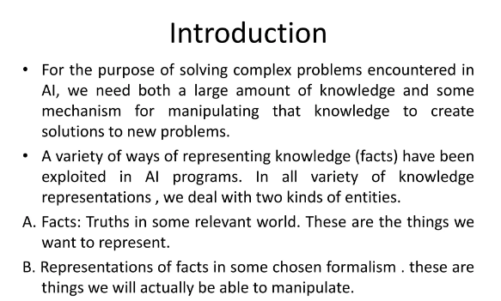

Slide 3
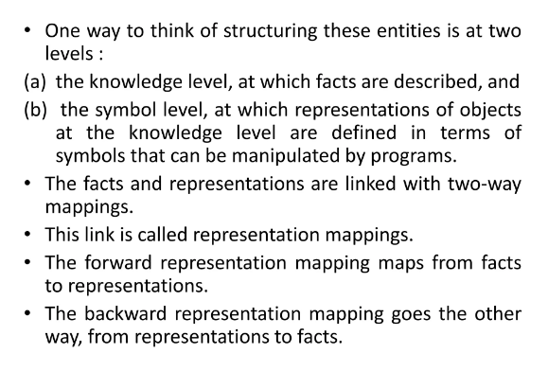

Slide 4
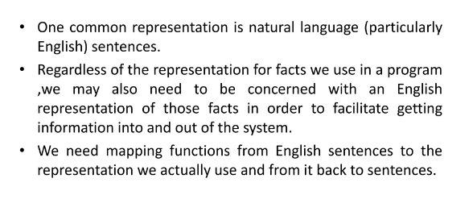

Slide 5
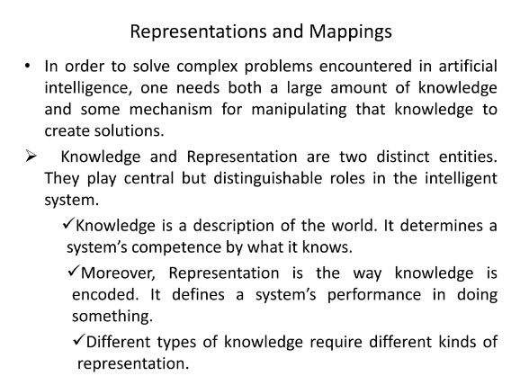

Slide 6
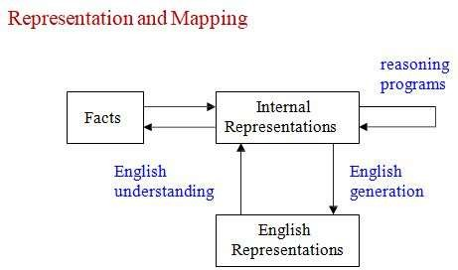
Representing facts in logic
Facts: Things we want to represent. Truth in some relevant world.
Representation of facts.

Slide 7
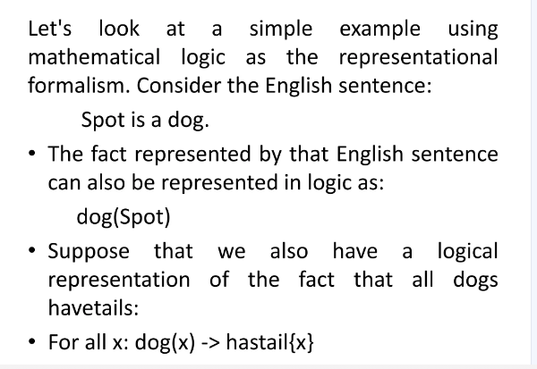

Slide 8
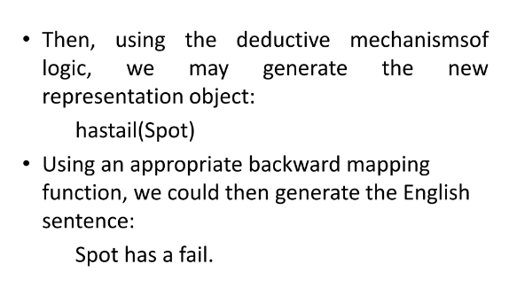

Slide 9
Knowledge Representation
What is Knowledge?:-
Knowledge is an useful term to judge the understanding of an individual on a given subject.
Knowledge is awareness or familiarity gained by experiences of facts, data, and situations. Following are the types of knowledge in artificial intelligence.
What is Knowledge Representation?
Artificial intelligence is a system that is concerned with the study of understanding, designing and implementing the ways, associated with knowledge representation to computers.
The main objective of AI system is to design the programs that provide information to the computer, which can be helpful to interact with humans and solve problems in various fields which require human intelligence.

Slide 10
What to Represent?:
Following are the kind of knowledge which needs to be represented in AI systems:
Object: All the facts about objects in our world domain.
E.g., Guitars contains strings, trumpets are brass instruments.
Events: Events are the actions which occur in our world.
Performance: It describe behavior which involves knowledge about how to do things.
Meta-knowledge: It is knowledge about what we know.
Facts: Facts are the truths about the real world and what we represent.
Knowledge-Base: The central component of the knowledge-based agents is the knowledge base. It is represented as KB.
The Knowledgebase is a group of the Sentences (Here, sentences are used as a technical
term and not identical with the English language).

Slide 11
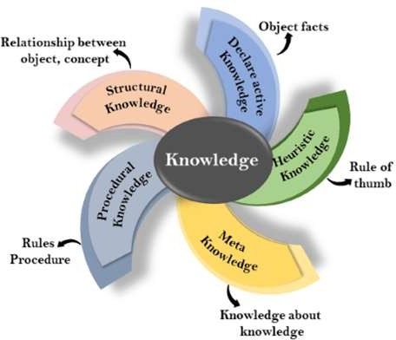
Types of knowledge
There are 5 types of Knowledge such as:
Declarative Knowledge
Procedural Knowledge
Meta-knowledge
Heuristic knowledge
Structural knowledge

Slide 12
1. Declarative Knowledge:-
Declarative knowledge is to know about something.
It includes concepts, facts, and objects.
It is also called descriptive knowledge and expressed in declarative sentences.
It is simpler than procedural language.
2. Procedural Knowledge:-
It is also known as imperative knowledge.
Procedural knowledge is a type of knowledge which is responsible for knowing how to do
something.
It can be directly applied to any task.
It includes rules, strategies, procedures, agendas, etc.
Procedural knowledge depends on the task on which it can be applied.
For example: Computer program.

Slide 13
3. Meta-knowledge:-
Knowledge about the other types of knowledge is called Meta-knowledge.
Meta-knowledge is helpful in enhancing the efficiency of problem solving through proper reasoning process.
4. Heuristic knowledge:-
Heuristic knowledge is based on thumb rule.
It provides the information based on a thumb rule, which is useful in guiding the reasoning process.
In this type, the knowledge representation is based on the strategies to solve the problems through the experience of past problems, compiled by an expert. Hence, it is also known as Shallow knowledge.

Slide 14
5.Structural knowledge:-
This type of knowledge helps establish relationships between concepts or objects and
their description, acting as the basic form of knowledge to solve real-world problems.

Slide 15
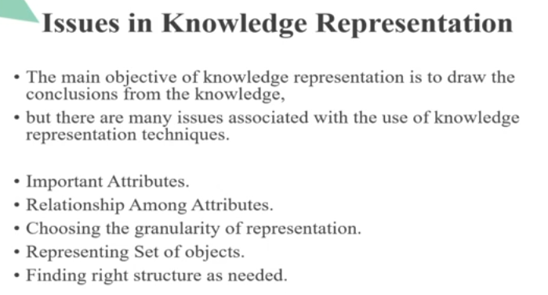

Slide 16
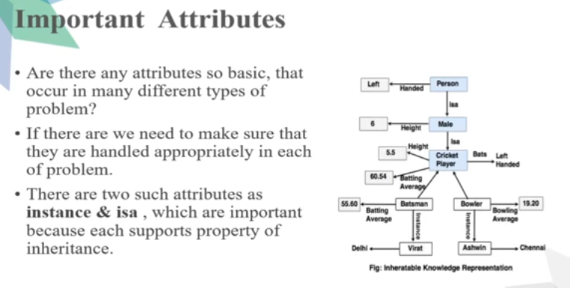

Slide 17
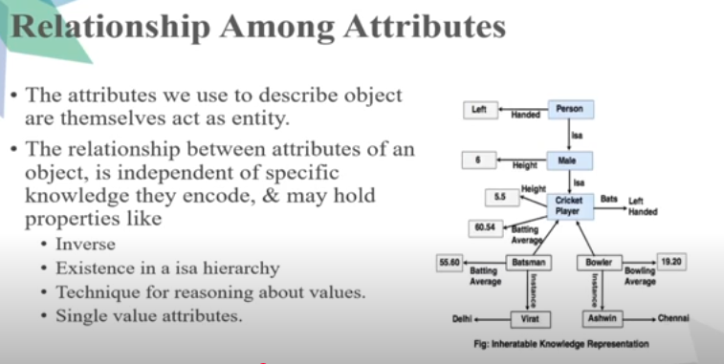

Slide 18
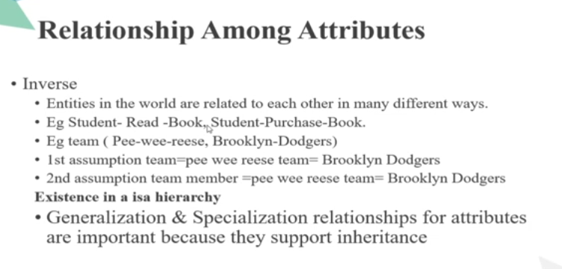

Slide 19
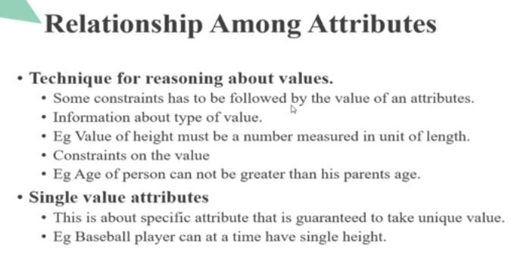

Slide 20
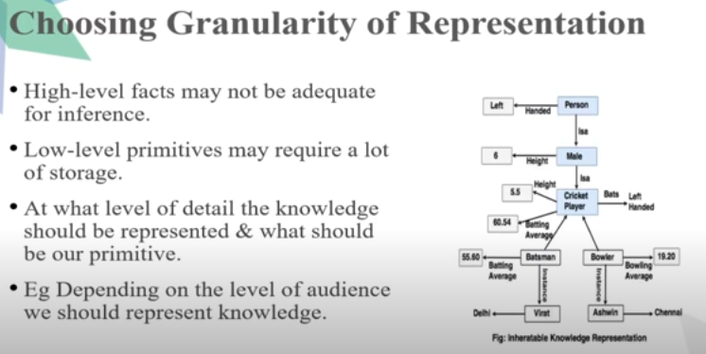

Slide 21
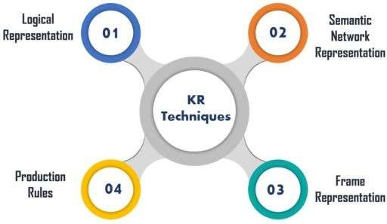
Techniques of Knowledge Representation in AI
There are four techniques of representing knowledge such as:

Slide 22
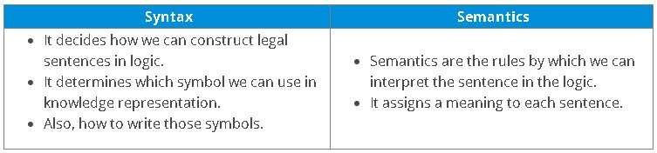
1. Logical Representation:-
Logical representation is a language with some definite rules which deal with
propositions and has no ambiguity in representation.
Also, it consists of precisely defined syntax and semantics which supports the sound
inference. Each sentence can be translated into logics using syntax and semantics.

Slide 23
Advantages:
Logical representation helps to perform logical reasoning.
This representation is the basis for the programming languages. Disadvantages:
Logical representations have some restrictions and are challenging to work with.
This technique may not be very natural, and inference may not be very efficient.

Slide 24
2. Semantic Network Representation:-
Semantic networks work as an alternative of predicate logic for knowledge
representation.
In Semantic networks, you can represent your knowledge in the form of graphical
networks.
This network consists of nodes representing objects and arcs which describe the relationship between those objects.
This representation consist of two types of relations:
IS-A relation (Inheritance)
Kind-of-relation

Slide 25
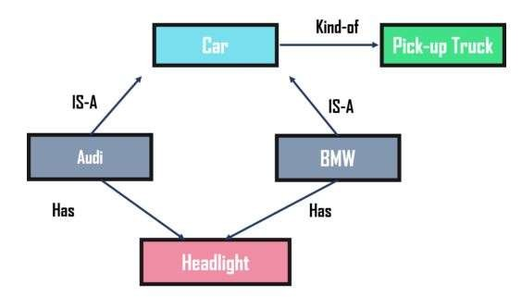
Example Semantic Network Representation
Advantages:
Semantic networks are a natural representation of knowledge.
Also, it conveys meaning in a transparent manner. These networks are simple and easy to understand. Disadvantages:
Semantic networks take more computational time at runtime.
Also, these are inadequate as they do not have any equivalent quantifiers.
These networks are not intelligent and depend on the creator of the system.

Slide 26
3. Frame Representation
A frame is a record like structure that consists of a collection of attributes and values to describe an
entity in the world.
These are the AI data structure that divides knowledge into substructures by representing stereotypes
situations.
Basically, it consists of a collection of slots and slot values of any type and size.
Slots have names and values which are called facets.
Advantages:
It makes the programming easier by grouping the related data.
Frame representation is easy to understand and visualize.
It is very easy to add slots for new attributes and relations.
Also, it is easy to include default data and search for missing values.

Slide 27
Disadvantages:
The inference mechanism cannot be smoothly proceeded by frame representation.
It has a very generalized approach.
4. Production Rules
In production rules, agent checks for the condition and if the condition exists then production
rule fires and corresponding action is carried out.
The condition part of the rule determines which rule may be applied to a problem.
Whereas, the action part carries out the associated problem-solving steps.
This complete process is called a recognize-act cycle.

Slide 28
The production rules system consists of three main parts:
The set of production rules
Working Memory
The recognize-act-cycle
Advantages:
The production rules are expressed in natural language.
The production rules are highly modular and can be easily removed or modified.
Disadvantages:
It does not exhibit any learning capabilities and does not store the result of the problem for
future uses.
During the execution of the program, many rules may be active. Thus, rule-based production systems are inefficient.

Slide 29
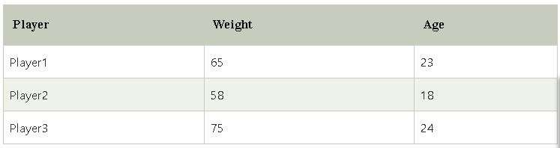
Approaches to knowledge representation in AI
There are mainly four approaches to knowledge representation, which are givenbelow:
Simple relational knowledge
Inheritable knowledge
Inferential knowledge
Procedural knowledge
1. Simple relational knowledge:-
This approach of knowledge representation is famous in where the relationship between different entities is represented in database systems
Example: The following is the simple relational knowledge representation.

Slide 30
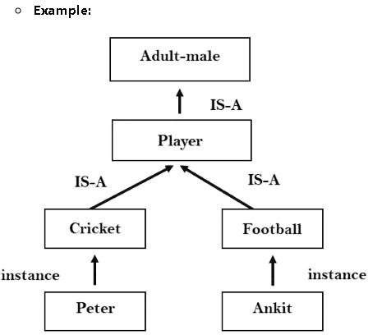
2. Inheritable knowledge:
In the inheritable knowledge approach, all data must be stored into a hierarchy of classes.

Slide 31
3. Inferential knowledge:
Inferential knowledge approach represents knowledge in the form of formal logics.
This approach can be used to derive more facts.
It guaranteed correctness.
Example: Let's suppose there are two statements:
  Marcus is a man
  All men are mortal
Then it can represent as;
man(Marcus)
∀x = man (x) ----------> mortal (x)

Slide 32
4. Procedural knowledge:
Procedural knowledge approach uses small programs and codes which describes how to do
specific things, and how to proceed.
In this approach, one important rule is used which is If-Then rule.
In this knowledge, we can use various coding languages such as LISP language and Prolog
language.

Slide 33
Knowledge Representation Using Predicate logic(First-order logic)
First-order logic is also known as Predicate logic or First-order predicate logic.
Predicate Logic deals with predicates, which are propositions, consist of variables.
Predicate Logic - Definition
A predicate is an expression of one or more variables determined on some specific domain.
A predicate with variables can be made a proposition by either authorizing a value to the
variable or by quantifying the variable.
First-order logic (like natural language) does not only assume that the world contains facts like
propositional logic but also assumes the following things in the world:
  Objects: A, B, people, numbers, colors, wars, theories, squares, pits, wumpus, ......
  Relations: It can be unary relation such as: red, round, is adjacent, or n-any relation such
as: the sister of, brother of, has color, comes between
  Function: Father of, best friend, end of, ......

Slide 34
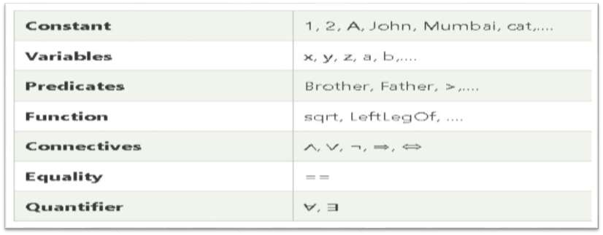
As a natural language, first-order logic also has two main parts:
Syntax
Semantics
Basic Elements of Predicate Logic(First-order logic):
Following are the basic elements of Predicate Logic or FOL syntax:

Slide 35

Atomic sentences:
Atomic sentences are the most basic sentences of first-order logic.
These sentences are formed from a predicate symbol followed by a parenthesis with a
sequence of terms.
SYNTAX:
Predicate (term1, term2, ......, term n).
EXAMPLE:
Ravi and Ajay are brothers: => Brothers(Ravi, Ajay).
Chinky is a cat: => cat (Chinky).

Slide 36

Complex Sentences:
Complex sentences are made by combining atomic sentences using connectives.
First-order logic statements can be divided into two parts:
Subject: Subject is the main part of the statement.
Predicate: A predicate can be defined as a relation, which binds two atoms together in a
statement.
EXAMPLE:
Consider the statement: "x is an integer.",
It consists of two parts, the first part x is the subject of the statement and second part "is an
integer," is known as a predicate.

Slide 37
Quantifiers in Predicate Logic (or) First-order logic:
These are the symbols that permit to determine or identify the range and scope of the variable in the
logical expression. There are two types of quantifier:
Universal Quantifier, (for all, everyone, everything)
Existential quantifier, (for some, at least one).
1. Universal Quantifier, (for all, everyone, everything):-
Universal quantifier is a symbol of logical representation, which specifies that the statement within its range is true for everything or every instance of a particular thing.
The Universal quantifier is represented by a symbol ∀, which resembles an inverted A.
NOTE :- In universal quantifier we use implication "→"
If x is a variable, then ∀x is read as:
For all x
For each x
For every x.

Slide 38
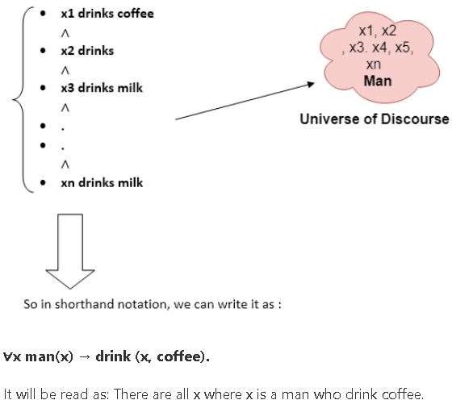
Example for Universal Quantifier
EXAMPLE:
All man drink coffee.
SOLUTION:-

Slide 39
Existential Quantifier:
Existential quantifiers are the type of quantifiers, which express that the statement within its
scope is true for at least one instance of something.
It is denoted by the logical operator ∃, which resembles as inverted E.
Note: In Existential quantifier we always use AND or Conjunction symbol (𝖠).
If x is a variable, then existential quantifier will be ∃x or ∃(x). And it will be read as:
There exists a 'x.'
For some 'x.'
For at least one 'x.'

Slide 40
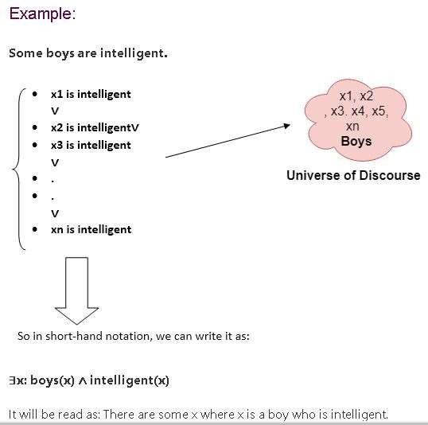
Example for Existential Quantifier

Slide 41
Properties of Quantifiers:
In universal quantifier, ∀x∀y is similar to ∀y∀x.
In Existential quantifier, ∃x∃y is similar to ∃y∃x.
∃x∀y is not similar to ∀y∃x.

Slide 42
Examples of Predicate Logic(FOL) using quantifier
All birds fly.
In this question the predicate is "fly(bird)."
And since there are all birds who fly so it will be represented as follows.
∀x bird(x) →fly(x).
Every man respects his parent.
In this question, the predicate is "respect(x, y)," where x=man, and y= parent.
Since there is every man so will use ∀, and it will be represented as follows:
∀x man(x) → respects (x, parent).
Some boys play cricket.
In this question, the predicate is "play(x, y)," where x= boys, and y= game. Since there are some boys so we will use ∃, and it will be represented as:
∃x boys(x) → play(x, cricket).

Slide 43
Not all students like both Mathematics and Science.
In this question, the predicate is "like(x, y)," where x= student, and y= subject. Since there are not all students, so we will use ∀ with negation, so following representation for this:
¬∀ (x) [ student(x) → like(x, Mathematics) 𝖠 like(x, Science)].
Only one student failed in Mathematics.
In this question, the predicate is "failed(x, y)," where x= student, and y= subject. Since there is only one student who failed in Mathematics, so we will use following representation for this:
∃(x) [ student(x) → failed (x, Mathematics) 𝖠∀ (y) [¬(x==y) 𝖠 student(y)
→ ¬failed (x, Mathematics)].

Slide 44
Free and Bound Variables:
The quantifiers interact with variables which appear in a suitable way. There are two
types of variables in First-order logic which are given below:
Free Variable: A variable is said to be a free variable in a formula if it occurs outside the
scope of the quantifier.
Example:
∀x ∃(y)[P (x, y, z)], where z is a free variable.
Bound Variable: A variable is said to be a bound variable in a formula if it occurs within the scope of the quantifier.
Example:
∀x [A (x) B( y)], here x and y are the bound variables.

Slide 45
Representing facts in logic
Facts: Things we want to represent. Truth in some relevant world.
Representation of facts.

Slide 46
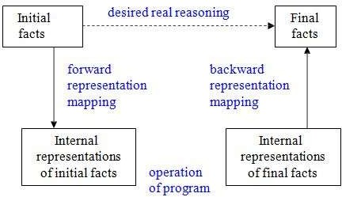

Slide 47
Representation and Mapping
Spot is a dog
Every dog has a tail
Spot has a tail
Spot is a dog dog(Spot)
Every dog has a tail
∀x: dog(x) → hastail(x)
hastail(Spot)
Spot has a tail

Slide 48
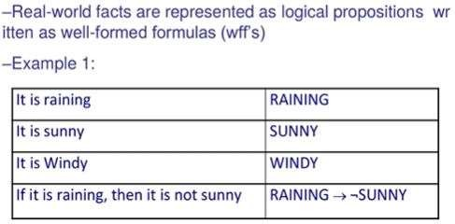
Using Propositional Logic

Slide 49
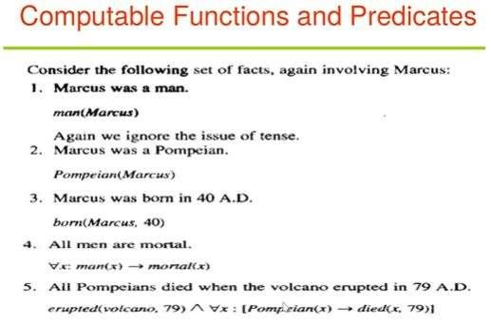
.

Slide 51
Conversion to clause form
Eliminate all ↔ connectives
(P ↔ Q) ⇒ ((P → Q) ^ (Q → P))
Eliminate all → connectives
(P → Q) ⇒ (¬P ∨ Q)
Reduce the scope of each negation symbol to a single predicate
¬¬P ⇒ P
¬(P ∨ Q) ⇒ ¬P ∧ ¬Q
¬(P ∧ Q) ⇒ ¬P ∨ ¬Q
¬(∀x)P ⇒ (∃x)¬P
¬(∃x)P ⇒ (∀x)¬P
Standardize variables: rename all variables so that each quantifier has its own unique variable name

Slide 52
5. Eliminate existential quantification by introducing Skolem constants/functions (∃x)P(x) ⇒ P(c)
c is a Skolem constant (a brand-new constant symbol that is not used in any other sentence)
(∀x)(∃y)P(x,y) becomes (∀x)P(x, F(x))
since ∃ is within the scope of a universally quantified variable, use a Skolem function F to construct a
new value that depends on the universally quantified variable
f must be a brand-new function name not occurring in any other sentence in the KB.
E.g., (∀x)(∃y)loves(x,y) becomes (∀x)loves(x,F(x))
In this case, F(x) specifies the person that x loves E.g., ∀x1 ∀x2 ∀x3 ∃y P(… y …) becomes
∀x1 ∀x2 ∀x3 P(… FF(x1,x2,x3) …) (FF is a new name)

Slide 53
Remove universal quantifiers by (1) moving them all to the left end; (2) making the scope of
each the entire sentence; and (3) dropping the “prefix” part
Ex: (∀x)P(x) ⇒ P(x)
Put into conjunctive normal form (conjunction of disjunctions) using distributive and
associative laws
(P ∧ Q) ∨ R ⇒ (P ∨ R) ∧ (Q ∨ R)
(P ∨ Q) ∨ R ⇒ (P ∨ Q ∨ R)
Split conjuncts into separate clauses
Standardize variables so each clause contains only variable names that do not occur in any
other clause.

Slide 54
An example
(∀x)(P(x) → ((∀y)(P(y) → P(F(x,y))) ∧ ¬(∀y)(Q(x,y) → P(y))))
Eliminate →
(∀x)(¬P(x) ∨ ((∀y)(¬P(y) ∨ P(F(x,y))) ∧ ¬(∀y)(¬Q(x,y) ∨ P(y))))
Reduce scope of negation
(∀x)(¬P(x) ∨ ((∀y)(¬P(y) ∨ P(F(x,y))) ∧(∃y)(Q(x,y) ∧ ¬P(y))))
Standardize variables
(∀x)(¬P(x) ∨ ((∀y)(¬P(y) ∨ P(F(x,y))) ∧(∃z)(Q(x,z) ∧ ¬P(z))))
Eliminate existential quantification
(∀x)(¬P(x) ∨((∀y)(¬P(y) ∨ P(F(x,y))) ∧(Q(x,G(x)) ∧ ¬P(G(x)))))
Drop universal quantification symbols
(¬P(x) ∨ ((¬P(y) ∨ P(F(x,y))) ∧(Q(x,G(x)) ∧ ¬P(G(x)))))

Slide 55
Convert to conjunction of disjunctions
(¬P(x) ∨ ¬P(y) ∨ P(F(x,y))) ∧ (¬P(x) ∨ Q(x,G(x))) ∧
(¬P(x) ∨ ¬P(G(x)))
Create separate clauses
¬P(x) ∨ ¬P(y) ∨ P(F(x,y))
¬P(x) ∨ Q(x,G(x))
¬P(x) ∨ ¬P(G(x))
Standardize variables
¬P(x) ∨ ¬P(y) ∨ P(F(x,y))
¬P(z) ∨ Q(z,G(z))
¬P(w) ∨ ¬P(G(w))
Note: Now that quantifiers are gone, we do need the upper/lower-case distinction

Slide 56
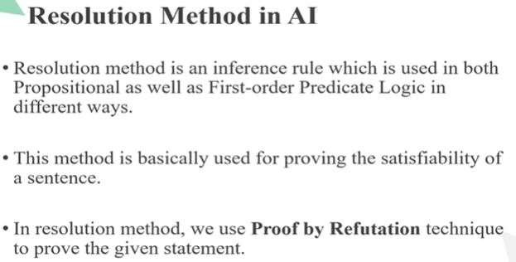

Slide 57
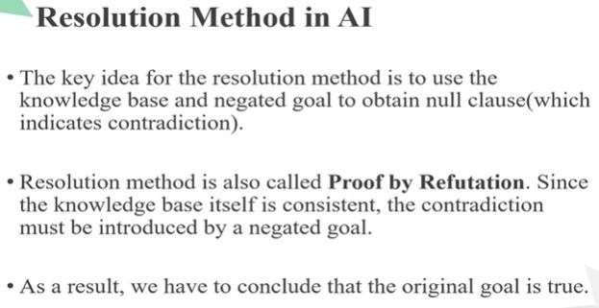

Slide 58
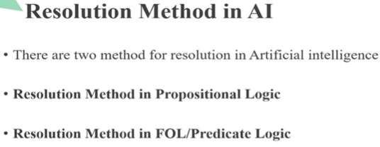

Slide 59
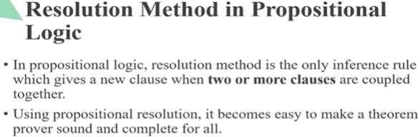

Slide 60
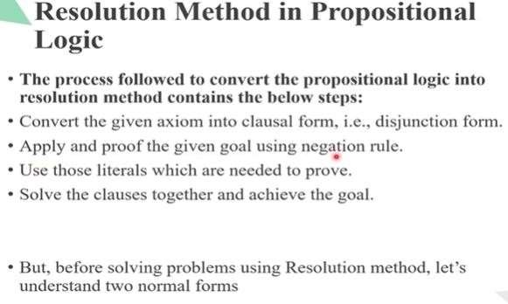

Slide 61
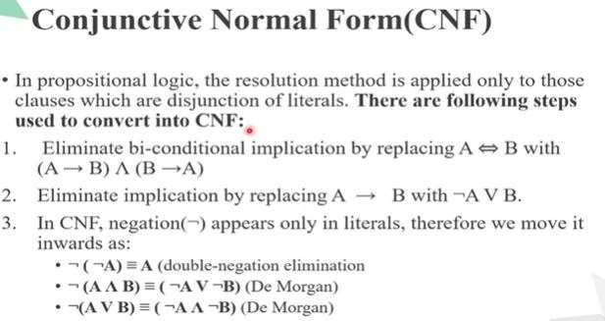

Slide 62
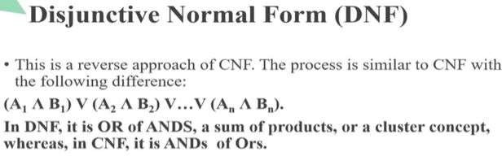

Slide 63
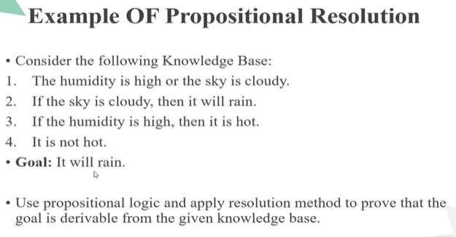

Slide 64
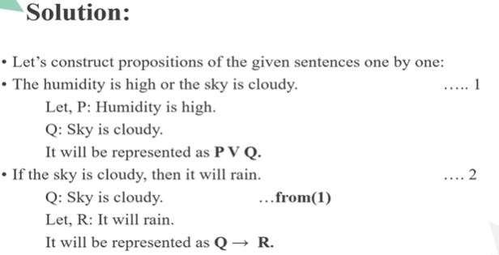

Slide 65
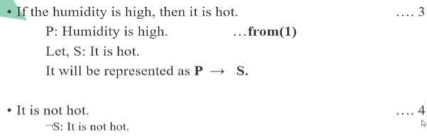

Slide 66
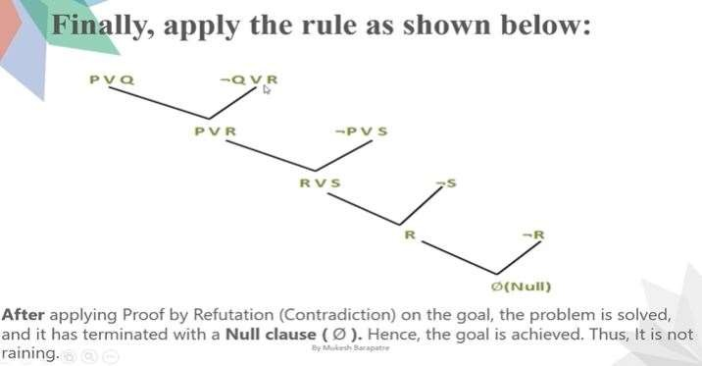

Slide 67
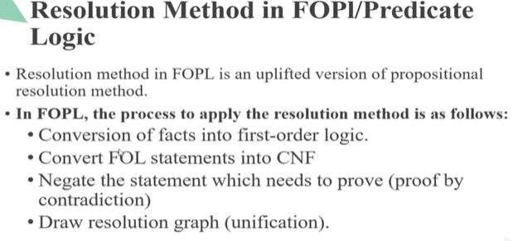

Slide 68
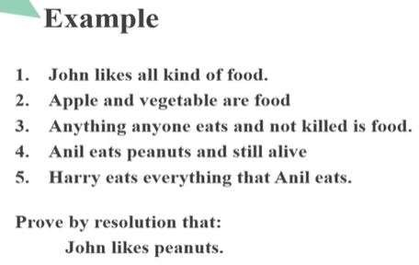

Slide 69
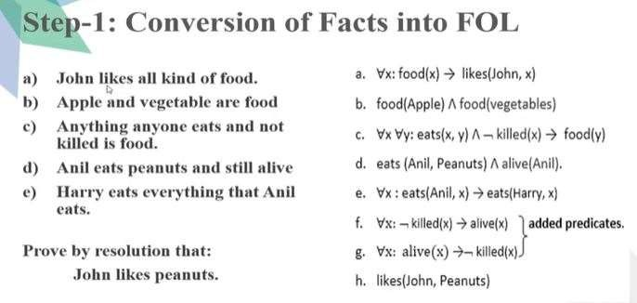

Slide 70
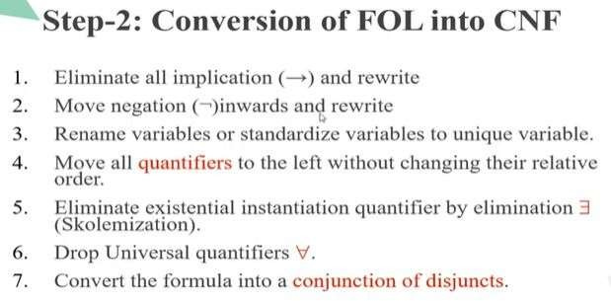

Slide 71
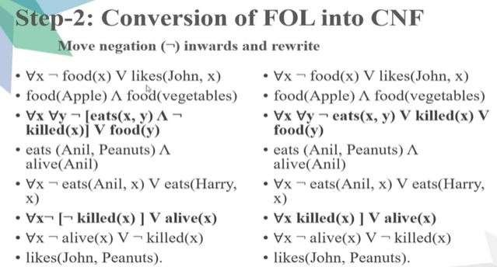

Slide 72
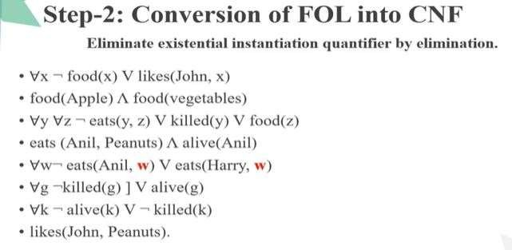

Slide 73
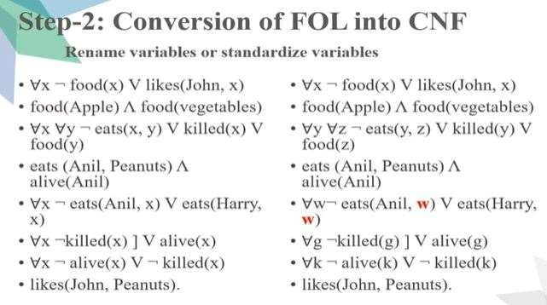

Slide 74
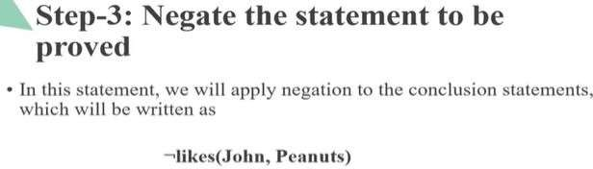

Slide 75
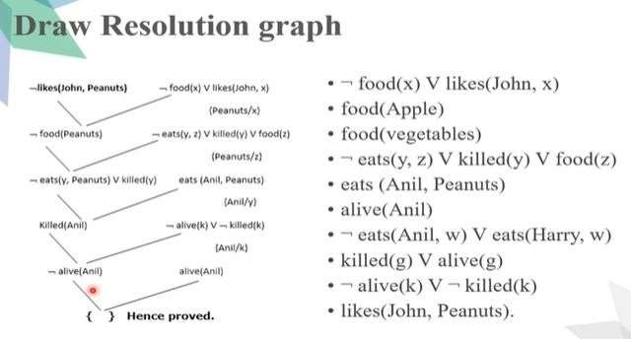

Slide 76
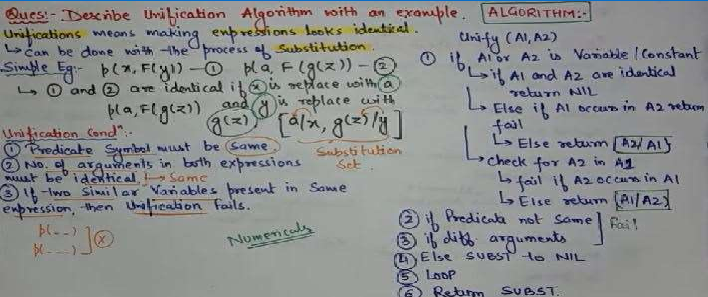
Unification

Slide 77
Unification Algorithm
Algorithm: Unify(L1, L2)
Step. 1: If L1 or L2 is a variable or constant, then:
If L1 or L2 are identical, then return NIL.
Else if L1 is a variable,
  then if L1 occurs in L2, then return FAILURE
  Else return { (L2/ L1)}.
Else if L2 is a variable,
  If L2 occurs in L1 then return FAILURE,
  Else return {( L1/ L2)}.
Else return FAILURE.
Step.2: If the initial Predicate symbol in L1 and L2 are not same, then return FAILURE.
Step. 3: IF L1 and L2 have a different number of arguments, then return FAILURE.
Step. 4: Set Substitution set(SUBST) to NIL. Step. 5: For i=1 to the number of elements in L1.
Call Unify function with the ith element of L1 and ith element of L2, and put the result into S.
If S = failure then returns Failure
If S ≠ NIL then do,
  Apply S to the remainder of both L1 and L2.
  SUBST= APPEND(S, SUBST). Step.6: Return SUBST.

Slide 78
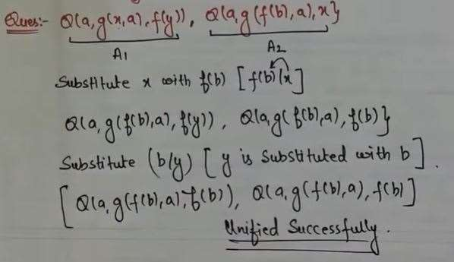

Slide 79
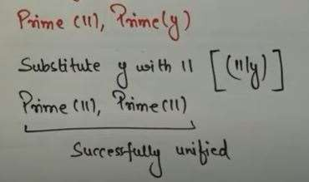

Slide 80
THANK YOU

